Slide 1
Machine Learning
Lesson 6: Unsupervised Learning

Slide 2

Unsupervised Learning
Hierarchical Clustering
Dendrogram
K means clustering

Slide 3
By the end of this lesson, you will be able to:
Explain the mechanism of unsupervised learning
Practice different clustering techniques in Python

Slide 4
Unsupervised Learning
Topic 1: Overview

Slide 5
Unsupervised Learning Process Flow
The data has no labels. The machine just looks for whatever patterns it can find.
Unsupervised Learning Model
Training Text,
Documents,
Images, etc.
Feature
Vectors
Machine
Learning
Algorithm
Feature
Vectors
Likelihood
or Cluster ID
or Better
Representation
New Text,
Document,
Images, etc.
Predictive
Model
Notes:
Trainer Notes: Explain the following:
Absence of labels in data
Above flowchart

Slide 6
Unsupervised Learning vs. Supervised Learning
The only difference is the labels in the training data
Feature
Vectors
Feature
Vectors
Training Text,
Documents,
Images, etc.
Training Text,
Documents,
Images, etc.
Machine
Learning
Algorithm
Machine
Learning
Algorithm
Labels
Feature
Vectors
Likelihood
or Cluster ID
or Better
Representation
New Text,
Document,
Images, etc.
Feature
Vectors
Predictive
Model
New Text,
Document,
Images, etc.
Predictive
Model
Expected
Label
Notes:
Trainer Notes: Explain the following:
Comparison between supervised learning and unsupervised learning with respect to labelled data
The output of supervised learning and unsupervised learning model

Slide 7





Unsupervised Learning: Example
Clustering like-looking birds/animals based on their features
Unsupervised
Learning
Notes:
Trainer Notes: Explain the following:
The above example with respect to unsupervised learning
Also, why it isn’t supervised learning

Slide 8
Application of Unsupervised Learning
Unsupervised learning can be used for anomaly detection as well as clustering
Anomaly detection
0.9
7
0.8
6
0.7
x
x
x
5
+
x
x
x
x
x
+
x
+
+
x
+
+
+
x
x
x
x
+
+
x
0.6
+
x
+
+
+
x
+
4
+
x
+
0.0033
3
0.5
0.0251
0.008
2
0.0119
0.4
1
0.3
0
-1
0.2
-2
0.1
0
2
4
6
8
10
0
0.1
0.2
0.3
0.4
0.5
0.6
0.7
0.8
0.9
0.1
Identifying similarities in groups
(Clustering)
Notes:
Trainer Notes: Explain the following:
How clustering is an unsupervised learning and real life applications of clustering
How unsupervised learning helps in anomaly detection

Slide 9
Unsupervised Learning
Topic 2: Clustering

Slide 10
Clustering
Grouping objects based on the information found in data that describes the objects or their relationship
The goal is to see that similar objects are grouped into one cluster and different from objects in another cluster
Cluster 0
Cluster 1
Cluster 2
Cluster 3
Cluster 4
Notes:
Trainer Notes: Explain the following:
A detailed explanation of clustering
What is the objective of clustering

Slide 11
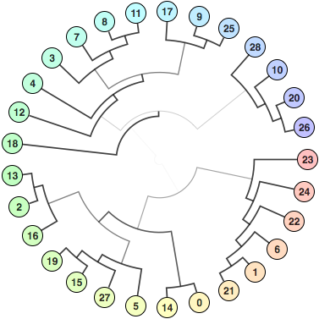
Need of Clustering
To determine the intrinsic grouping in a set of unlabeled data
To organize data into clusters showing internal structure of the data
To partition the data points
To understand and extract value from large sets of structured and unstructured data
Notes:
Trainer Notes: Explain the following:
1. Need and significance of clustering in detail

Slide 12
Types of Clustering
Clustering
Hierarchical
clustering
Partitional
clustering
Agglomerative
Divisive
K-means
Fuzzy C-means
Notes:
Trainer Notes: Explain the following:
Types of clustering
Difference between Hierarchical and Partitional Clustering

Slide 13
Unsupervised Learning
Topic 3: Hierarchical Clustering
Notes:
Trainer Notes: Explain the following:
1. Scenarios where hierarchical clustering is helpful

Slide 14
Hierarchical Clustering
Outputs a hierarchy, a structure that is more informative than the unstructured set of clusters returned by flat clustering
B
C
B
C
B
C
B
C
A
A
A
A
D
D
D
D
F
E
F
E
F
E
F
E
Dissimilarity
Dissimilarity
Dissimilarity
Dissimilarity
A
B
C
D
E
A
B
C
D
E
F
A
B
C
D
E
F
A
B
C
D
E
F
Combine A and B based on similarity
Combine D and E based on similarity
Combination of A and B is combined
with C
Combination of D and E is combined
with F
Final tree contains all clusters
Combined into a single cluster
1
2
3
4
Notes:
Trainer Notes: Explain the following:
The above image with respect to hierarchical clustering
A&B, D&E -> A,B&C, D&F -> -----

Slide 15
Working: Hierarchical Clustering
Step 1
Step 2
Step 3
Step 4
Assign each item to its own cluster, such that if you have N number of items, you now have N number of clusters
Find the closest (most similar) pair of clusters and merge them into a single cluster. Now you have one less cluster
Compute distances (similarities) between the new cluster and every old cluster
Repeat steps 2 and 3 until all items are clustered into a single cluster of size N
Notes:
Trainer Notes: Explain the following:
Working of hierarchical clustering with a rough sketch diagram
The above points in detail

Slide 16
Distance Measures
Complete - Linkage clustering
Find the maximum possible distance between points belonging to two different clusters
Single - Linkage Clustering
Find the minimum possible distance between points belonging to two different clusters
Mean - Linkage Clustering
Find all possible pair-wise distances for points belonging to two different clusters and then calculate the average
Centroid - Linkage Clustering
Find the centroids of each cluster and calculate the distance between them
Notes:
Trainer Notes: Explain the following:
The above distance measures in detail
Significance of different distance measures

Slide 17
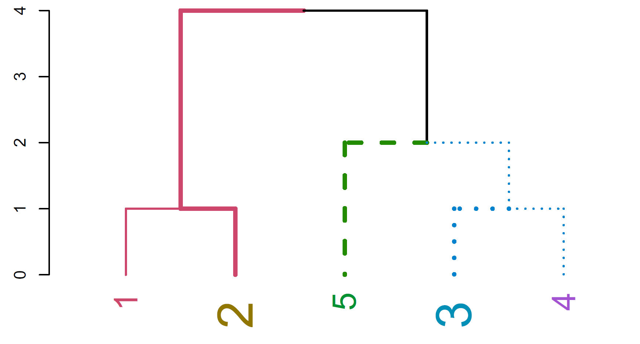
The Dendrogram
Dendrogram ((in Greek, dendro means tree and gramma means drawing) is a tree diagram frequently used to illustrate the arrangement of the clusters produced by hierarchical clustering.
Agglomerative
Divisive
Notes:
Trainer Notes: Explain the following:
Significance of a dendrogrm
Agglomerative and divisive approach of dendrogram formulation

Slide 18
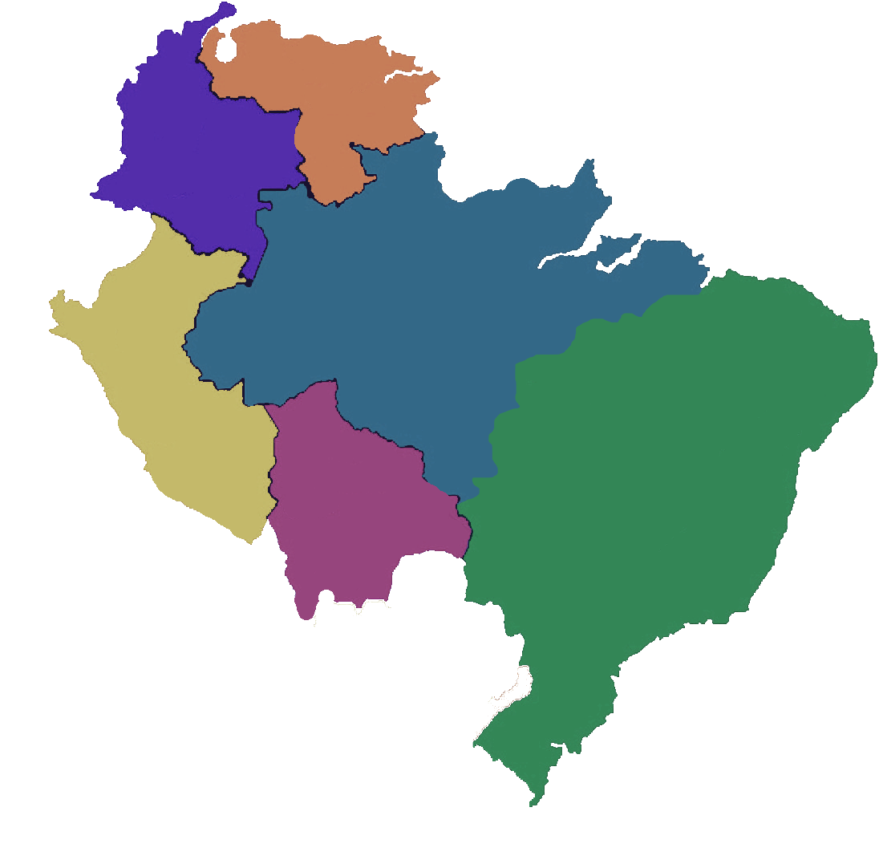
Hierarchical Clustering: Example
A hierarchical clustering of distances between cities in kilometers
MI
TO
FI
RM
NA
BA
BA
NA
RM
RM
FI
TO
MI
Notes:
Trainer Notes: Explain the following:
The above example with respect to clustering wherein the cities are clustered based on the distance between them

Slide 19
Hierarchical Clustering: Step 1
Create distance matrix of data
 | BA | FI | MI | NA | RM | TO
BA | 0 | 662 | 877 | 255 | 412 | 996
FI | 662 | 0 | 295 | 468 | 268 | 400
MI | 877 | 295 | 0 | 754 | 564 | 138
NA | 255 | 468 | 754 | 0 | 219 | 869
RM | 412 | 268 | 564 | 219 | 0 | 669
TO | 996 | 400 | 138 | 869 | 669 | 0
Distance between TO and MI
Distance Matrix
Notes:
Trainer Notes: Explain the following:
1. The above random matrix as step 1 towards clustering

Slide 20
Hierarchical Clustering: Step 2
From the distance matrix, you can see that MI has least distance with TO and they form a cluster together
 | BA | FI | MI | NA | RM | TO
BA | 0 | 662 | 877 | 255 | 412 | 996
FI | 662 | 0 | 295 | 468 | 268 | 400
MI | 877 | 295 | 0 | 754 | 564 | 138
NA | 255 | 468 | 754 | 0 | 219 | 869
RM | 412 | 268 | 564 | 219 | 0 | 669
TO | 996 | 400 | 138 | 869 | 669 | 0
 | BA | FI | MI/TO | NA | RM
BA | 0 | 662 | 877 | 255 | 412
FI | 662 | 0 | 295 | 468 | 268
MI/TO | 877 | 295 | 0 | 754 | 564
NA | 255 | 468 | 754 | 0 | 219
RM | 412 | 268 | 564 | 219 | 0
TO
MI
As the MI column has lower values than TO column, MI/TO consists of MI column values
Notes:
Trainer Notes: Explain the following:
Data points with least distance between them form a cluster together with respect to the above step
Also, why some places have values as 0

Slide 21
Hierarchical Clustering: Step 3
Repeat clustering until a single cluster is obtained with all the members in it
 | BA | FI | MI/TO | NA | RM
BA | 0 | 662 | 877 | 255 | 412
FI | 662 | 0 | 295 | 468 | 268
MI/TO | 877 | 295 | 0 | 754 | 564
NA | 255 | 468 | 754 | 0 | 219
RM | 412 | 268 | 564 | 219 | 0
NA
RM
TO
MI
 | BA | FI | MI/TO | NA/RM
BA | 0 | 662 | 877 | 255
FI | 662 | 0 | 295 | 268
MI/TO | 877 | 295 | 0 | 564
NA/RM | 255 | 468 | 564 | 0
Notes:
Trainer Notes: Explain the following:
Repetitive process

Slide 22
Hierarchical Clustering: Step 3 (Contd.)
 | BA | FI | MI/TO | NA/RM
BA | 0 | 662 | 877 | 255
FI | 662 | 0 | 295 | 268
MI/TO | 877 | 295 | 0 | 564
NA/RM | 255 | 268 | 564 | 0
NA
RM
TO
MI
 | BA/(NA/RM) | FI | MI/TO
BA/(NA/RM) | 0 | 268 | 564
FI | 268 | 0 | 295
MI/TO | 564 | 295 | 0
Notes:
Trainer Notes: Explain the following:
Formation of BA/(NA/RM)

Slide 23
Hierarchical Clustering: Step 3 (Contd.)
 | BA/(NA/RM) | FI | MI/TO
BA/(NA/RM) | 0 | 268 | 564
FI | 268 | 0 | 295
MI/TO | 564 | 295 | 0
BA
NA
RM
FI
TO
MI
 | BA/(NA/RM)/FI | (MI/TO)
BA/(NA/RM)/FI | 0 | 295
(MI/TO) | 295 | 0
Notes:
Trainer Notes: Explain the following:
Formation of BA/(NA/RM)/FI

Slide 24
Hierarchical Clustering: Step 4
Derive the final dendrogram
 | BA/(NA/RM)/FI | (MI/TO)
BA/(NA/RM)/FI | 0 | 295
(MI/TO) | 295 | 0
BA
NA
RM
FI
TO
MI
Notes:
Trainer Notes: Explain the following:
Constructing the final dendrogram (shown above)

Slide 25
Assisted Practice
Hierarchical Clustering
Duration: 15 mins.
Problem Statement: Consider the dataset “zoo.data” and look at the info in the first five rows. The first column denotes the animal name and the last one specifies a high-level class for the corresponding animal. Find a solution to the following questions:
Unique number of high-level class
Perform agglomerative clustering using the 16 intermediate features [ Hint: Refer to the agglomerative clustering (Hierarchical Clustering) module in Scikit learn and set the number of clusters appropriately ]
Refer the below link for further documentation:
http://scikit-learn.org/stable/modules/generated/sklearn.cluster.AgglomerativeClustering.html
Compute the mean squared error by comparing the actual class and predicted high-level class.
Objective: Perform agglomerative clustering with appropriate MSE value.
Access: Click on the Labs tab on the left side panel of the LMS. Copy or note the username and password that are generated. Click on the Launch Lab button. On the page that appears, enter the username and password in the respective fields, and click Login.
Notes:
Trainer Notes:
Explain the above scenario
Download the zoo.csv and the corresponding .ipynb file as a reference to demonstrate the above problem
Ask the learners to perform the practice simultaneously on their local system

Slide 26
Unassisted Practice
Hierarchical Clustering Duration: 10 mins.
Problem Statement: An ecommerce company has prepared a rough dataset containing shopping details of their customers, which includes CustomerID, Genre, Age, Annual Income (k$), Spending Score (1-100). The company is unable to target a specific set of customers with a particular set of SKUs.
Objective: Segment customers into different groups based on their shopping trends.
Note: This practice is not graded. It is only intended for you to apply the knowledge you have gained to solve real-world problems.
Access: Click on the Labs tab on the left side panel of the LMS. Copy or note the username and password that are generated. Click on the Launch Lab button. On the page that appears, enter the username and password in the respective fields, and click Login.
Notes:
Trainer Notes: Explain the following:
The above scenario
Ask the learners to download the shopping_data.csv file to start with the practice

Slide 27
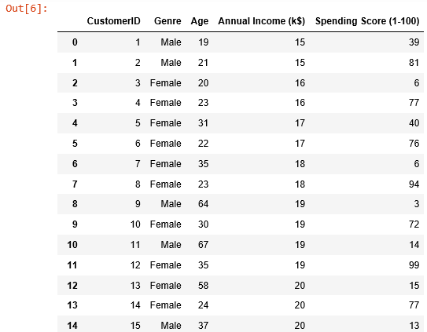
Step1: Data Import
Code
import pandas as pd
import numpy as np
customer_data = pd.read_csv('shopping_data.csv’)
customer_data

Slide 28
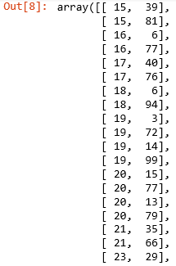
Step 2: Filter Columns
Discard all the data, except annual income (in thousands of dollars) and spending score (1-100)
Code
data = customer_data.iloc[:,3:5].values
data

Slide 29
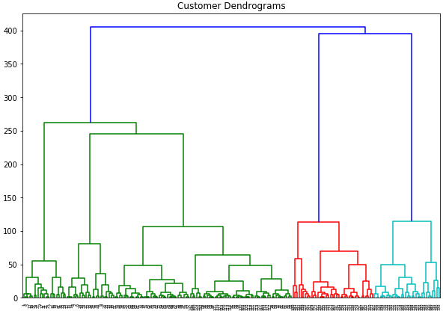
Step 3: Create Dendrograms
Code
import matplotlib.pyplot as plt
%matplotlib inline
import scipy.cluster.hierarchy as shc
plt.figure(figsize=(10,7))
plt.title('Customer Dendrograms')
dend = shc.dendrogram(shc.linkage(data,method='ward'))
5 Clusters
Notes:
Trainer notes:
Explain method=‘ward’ in linkage function

Slide 30
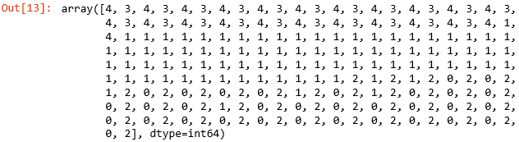
Step 4: Agglomerative Clustering
Since there are five clusters, group the data points into these five clusters
Code
from sklearn.cluster import AgglomerativeClustering
cluster = AgglomerativeClustering(n_clusters=5, affinity='euclidean', linkage='ward')
cluster.fit_predict(data)
Notes:
Trainer notes:
Explain agglomerative function parameters

Slide 31
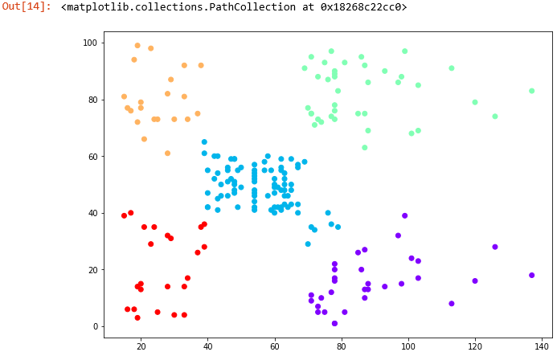
Step 4: Plotting the Clusters
Code
plt.figure(figsize=(10, 7))
plt.scatter(data[:,0], data[:,1], c=cluster.labels_, cmap='rainbow')

Slide 32
Unsupervised Learning
Topic 4: K-means Clustering

Slide 33
K-means Algorithm: Steps
1
Randomly chooses k datapoints as initial centroids
2
Assigns each datapoint closest to the centroid
3
Calculates new cluster centroids
4
Checks if the convergence criterion is met
Notes:
Trainer Notes: Explain the following:
K means algorithm and its significance
The above steps

Slide 34
K-means: Example
Consider the below datapoints
Notes:
Trainer Notes: Explain the following:
The above scenario with random datapoints and that they have to be grouped based on k means clustering

Slide 35
K-means: Example (Contd.)
Initialize centers randomly
Notes:
Trainer Notes: Explain the following:
Centre Initialization and different means of initializing centres

Slide 36
K-means: Example (Contd.)
Assign points to the nearest center
Notes:
Trainer Notes: Explain the following:
Data point assignment to centres

Slide 37
K-means: Example (Contd.)
Readjust centers
Notes:
Trainer Notes: Explain the following:
Re moving centres
Why the centres are moving

Slide 38
K-means: Example (Contd.)
Assign points to the nearest center
Notes:
Trainer Notes: Explain the following:
Again datapoint assignment

Slide 39
K-means: Example (Contd.)
Re-adjust centres
Notes:
Trainer Notes: Explain the following:
Centre Readjustment

Slide 40
K-means: Example (Contd.)
Assign points to the nearest center
Notes:
Trainer Notes: Explain the following:
Data point assignment

Slide 41
K-means: Example (Contd.)
Readjust centers
Notes:
Trainer Notes: Explain the following:
Centre readjustment

Slide 42
K-means: Example (Contd.)
Assign points to the nearest center
Notes:
Trainer Notes: Explain the following:
Datapoint assignment

Slide 43
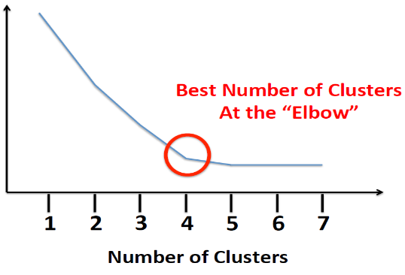
Optimal Number of Clusters
If you plot k against the SSE, you will see that the error decreases as k increases
This is because their size decreases and hence distortion is also smaller"
Objective Function Value
i.e., Distortion
The goal of elbow method is to choose k where SSE decreases abruptly
Elbow Plot
Notes:
Trainer Notes: Explain the following:
what is optimal cluster number and its significance
The elbow/scree plot

Slide 44
Assisted Practice
K-means Clustering
Duration: 15 mins.
Problem Statement: Lithionpower is the largest provider of electric vehicle(e-vehicle) batteries. It provides battery on a rental model to e-vehicle drivers. Drivers rent battery typically for a day and then replace it with a charged battery from the company.
Lithionpower has a variable pricing model based on driver's driving history. Battery life depends on factors such as over speeding, distance driven per day, etc.
Objective:
Create a cluster model where drivers can be grouped together based on the driving data.
Group the datapoints so that drivers will be incentivized based on the cluster.
Access: Click on the Labs tab on the left side panel of the LMS. Copy or note the username and password that are generated. Click on the Launch Lab button. On the page that appears, enter the username and password in the respective fields, and click Login.
Notes:
Trainer Notes:
Explain the above scenario
Download the driver-data.csv and the corresponding .ipynb file as a reference to demonstrate the above problem
Ask the learners to perform the practice simultaneously on their local system

Slide 45
Unassisted Practice
K-means Clustering Duration: 10 mins.
Problem Statement: There is an image in the name of “tiger.png”. Use k-means clustering with k set to 16 and cluster the image, which means that you want to keep just 16 colors in our compressed image.
Objective: Open and display the image “tiger.png”. Convert the image into numpy array, so that it can be used in further processing. Find out the dimensions of the image and convert it into a two-dimensional array (Use k-means clustering for image segmentation, reducing the image into 16 colors).
Note: This practice is not graded. It is only intended for you to apply the knowledge you have gained to solve real-world problems.
Access: Click on the Labs tab on the left side panel of the LMS. Copy or note the username and password that are generated. Click on the Launch Lab button. On the page that appears, enter the username and password in the respective fields, and click Login.
Notes:
Trainer Notes: Explain the following:
The above scenario
Also, ask them to go through PIL documentation before starting with this practice
Ask the learners to download the tiger.png file to start with the practice

Slide 46
Step 1: Import Libraries
Code
from sklearn.cluster import KMeans
import numpy as np
from PIL import Image
import matplotlib.pyplot as plt
import matplotlib.image as mpimg
import os
%matplotlib inline

Slide 47
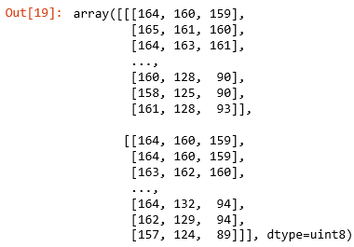
Step 2: Get the Image and its Corresponding RGB Values
Code
img = Image.open('tiger.png’)
img_np=np.asarray(img)
img_np[0:2]

Slide 48
Step 3: Get the Image Dimensions
Code
img_np.shape
For feeding this data into the algorithm, you must change the shape of this data into a dataset with 720*1280 = 921600 rows and 3 columns

Slide 49
Step 4: Reshape the Data
Code
pixels=img_np.reshape(img_np.shape[0]*img_np.shape[1],img_np.shape[2])
pixels.shape
Notes:
Trainer notes:
Explain the need to reshape the image

Slide 50
Step 5: Define the K-means Model
Code
model=KMeans(n_clusters=16)
model.fit(pixels)
After the model is trained, model.labels_ is used to obtain the number of cluster that is assigned to each data point or each pixel.
model.cluster_centers_ gives us the coordinates or the RGB values of the 16 cluster centers.

Slide 51
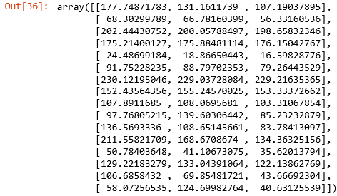
Step 6: Define the Cluster Centres
Code
pixel_centroids = model.labels_
cluster_centers=model.cluster_centers_
pixel_centroids
Code
cluster_centers

Slide 52

Step 7: Cluster Assignment
Code
final=np.zeros((pixel_centroids.shape[0],3))
for cluster_no in range(16):
final[pixel_centroids==cluster_no]=cluster_centers[cluster_no]
final[0:5]

Slide 53
Step 8: Reshape to Original Dimensions
Code
comp_image=final.reshape(img_np.shape[0],img_np.shape[1],3)
comp_image.shape

Slide 54
Step 9: Convert the Pixel Values to Image
Code
comp_image=Image.fromarray(np.uint8(comp_image))
comp_image.save('tiger_compressed.png’)
img_1 = mpimg.imread('tiger.png')
img_2 = mpimg.imread('tiger_compressed.png')

Slide 55
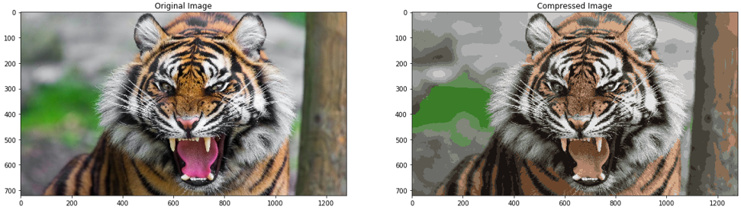
Step 10: Original Plot vs. Compressed Image
Code
fig,(ax1,ax2) = plt.subplots(1,2, figsize=(20,20))
ax1.imshow(img_1)
ax1.set_title('Original Image')
ax2.imshow(img_2)
ax2.set_title('Compressed Image')
plt.show()

Slide 56
Now, you are able to:
Explain the mechanism of unsupervised learning
Practice different clustering techniques in Python

Slide 57

© Simplilearn. All rights reserved.

Slide 58
Can decision trees be used for performing clustering?
1
True
False
© Simplilearn. All rights reserved.

Slide 59
Can decision trees be used for performing clustering?
1
True
False
a. True
Decision trees can also be used to for clusters in the data, but it often generates natural clusters and is not dependent on any objective function.

Slide 60
Which of the following can act as possible termination condition in K-Means?
1. Fixed number of iterations.
2. Assigning observations to clusters such that they don’t change between iterations, except for cases with a bad local minimum.
3. Stationary centroids appear between successive iterations.
4. When RSS falls below a threshold.
2
1,3, and 4
1, 2, and 3
1, 2, and 4
All the above
© Simplilearn. All rights reserved.

Slide 61
Which of the following can act as possible termination condition in K-Means?
1. Fixed number of iterations.
2. Assigning observations to clusters such that they don’t change between iterations, except for cases with a bad local minimum.
3. Stationary centroids appear between successive iterations.
4. When RSS falls below a threshold.
2
1,3, and 4
1, 2, and 3
1, 2, and 4
All the above
d. All the above
All the above options are true.

Slide 62
Lesson-End Project
Duration: 20 mins.
Problem Statement: Open and display the image “dog.jpeg”. The image has to be converted in to numpy array, so that it can be used in further processing. The major challenge is to identify the dominant color in the image
[Hint: Refer the following url for image processing documentation: http://omz-software.com/pythonista/docs/ios/PIL.html]
Objective: Use K-means clustering for image segmentation, which will include the following steps:
Find out the dimensions of the image and convert it in to a two-dimensional array.
Use k-means clustering with k set to 3 and cluster the image.
[Hint: Refer to k-means module of scikit learn]
Predict the cluster label of every pixel in the image and plot it back as an image.
Find out the three dominant color in the image.
[Hint: The cluster centers should correspond to three dominant colors]
Access: Click the Labs tab in the left side panel of the LMS. Copy or note the username and password that are generated. Click the Launch Lab button. On the page that appears, enter the username and password in the respective fields and click Login.
Notes:
Trainer Notes: Explain the project to the learners and instruct them to perform it after the lesson.

Slide 63
© Simplilearn. All rights reserved.

